Slide 1


MASTERCLASS
Cross-border eCommerce: From Basics to Business Growth
Mandy Deakin-Snell
CEO of MDS Alignment and Head of NeX Academy
Marrakech, 8th June 2026

Slide 2





BACKGROUND
C-Suite
International MD, GeoPost Group (La Poste) · Operations Director, DPD UK
Created International Divisions and Award-winning teams, working with Global eCommerce brands.
Founder
MDS Alignment · Consulting · Executive Coaching · Aligned Leadership Training
A business offering know-how and training in people development and logistics solutions.
Mandy Deakin-Snell
Advisor
Founder & CEO MDS Alignment
ATEM Group · NEX eCommerce · Head of NeX Academy
International operational efficiency and educating the next generation of supply chain leaders.
Speaker
Keynote Speaker · Podcasts · Author · Volunteer Student Mentor
A passion for sharing knowledge and supporting the younger generation through times of change.
Copyright MDS Alignment LTD. 2026

Slide 3
We will explore
The eCommerce ecosystem
From online order to final mile to discover where traditional air cargo and airline models need to adapt to meet the expectations of digital-first customers and retailers.
With interactive questions…for you!
Copyright MDS Alignment LTD. 2026

Slide 4
By the end of this Masterclass
You will have:
A clearer understanding of the eCommerce landscape
Knowledge of the essential language, tools, and platforms
An understanding of retailer expectations and KPIs
Insights into ways that your business can add value
Practical ways to attract and retain eCommerce clients
Copyright MDS Alignment LTD. 2026

Slide 5

Reflect on your current processes.
The more you connect the learning to your day-to-day reality,
the more value you’ll get.

Slide 6
SECTION 1
The eCommerce Landscape
Cross-Border eCommerce: From Basics to Business Growth

Slide 7



What is eCommerce?
Online
Buying and selling
Includes
Big brands, small shops
Clicks
Create a logistics need

Slide 8
eCommerce is Reshaping Global Air Cargo
18%
48%
80%
of global air cargo
of volumes on key
of all cross-border
is eCommerce (2025)
eCommerce trade lanes
eCommerce ships by air
Up from just 10% in 2017
Asia-Pacific, US, Europe corridors
Verified by IATA, McKinsey & PwC
GROWTH OF eCOMMERCE SHARE OF AIR CARGO
eCommerce is now the growth engine for air cargo,
and on track to reach 20–25% of all air cargo by 2027
Asia-Pacific accounts for over 56% of all major eCommerce air freight corridors globally
Sources: McKinsey, Aevean / IATA WCS

Slide 9
Revenue Development of the Global eCommerce Market
US$ Trillions
Actual
Forecast
Forecast →
+6.8%
+9.7%
+24%
(COVID)
Source: eMarketer via Shopify Global eCommerce Sales Growth Report (2026) & Capital One Shopping Research (Mar 2026). Retail eCommerce, global.

Slide 10
Global eCommerce Revenue in US$ Billion
2025 Estimates
Australia & Oceania
China
$3,250B (51%)
United States
$1,392B (22%)
Europe
$750B (12%)
Asia (minus China)
$710B (11%)
Americas (minus US)
$191B (3%)
Australia & Oceania
$62B (1%)
Africa
$30B (<1%)
Total Market 2025
$6,385B
Sources: eMarketer via Shopify Global eCommerce Sales Growth Report (2026) & Capital One Shopping Research (Mar 2026). China data: eMarketer / Yaguara (2026). Europe: Capital One Shopping (2026). Latin America: eMarketer / EMARKETER Forecast (Oct 2025). Figures are retail B2C eCommerce estimates.

Slide 11
eCommerce Markets Revenue by Continent in Terms of Percentage Growth Rate
Between 2025* and 2029* in US$ Billion
Americas
Europe
Africa
Asia
Australia²
+36.1%
+27.1%
+52.4%
+42.7%
+39.7%
$1.79T
$957B
$32B
$4.13T
$81B
$753B
$1.32T
$2.89T
$58B
$21B
2025
2029
2025
2029
2025
2029
2025
2029
2025
2029
* 2025 estimated; 2029 forecast. Growth rates consistent with ECDB 2024–2028 CAGRs (Americas +36.1%, Europe +27.1%, Africa +52.4%, Asia +42.7%, Australia & Oceania +39.7%). ² Includes Oceania.
Sources: ECDB (eCommerce DB) — Global eCommerce Development from a Continental Perspective (Jan 2025). Regional CAGRs confirmed via eCommerce Germany / ECDB Report (Jan 2026) and Shopify Global eCommerce Statistics (2026).
mdsalignment.com

Slide 12

Networking Activity:
Turn to the person next to you and discuss this question…

Slide 13
?
Open Question
What region/s are you strongest in today?
Where do you also see areas of opportunity?

Slide 14
SECTION2
Cross Border eCommerce 101
Cross-Border eCommerce: From Basics to Business Growth

Slide 15
Cross-border eCommerce is…
High Volume, Low Value, Consumer-Focused, Speed Sensitive
You need to know…
The difference between a shipper and a consumer as the end customer
Margins come from volume throughput, not per-shipment fees
Speed as a product feature, not just a service metric
Visibility expectations: Consumers expect tracking at every touchpoint
The "last mile" is where most cost and failures can occur
Copyright MDS Alignment LTD. 2026

Slide 16
Customs, Duties and Compliance
De minimis thresholds
HS codes at parcel level
Incoterms in B2C
VAT compliance frameworks
Prohibited and restricted goods
Sanctions and denied parties
Country specific challenges…

Slide 17

BRAZIL – Remessa Conforme & ICMS

Slide 18
🇧🇷 Country-Specific Challenges: Brazil eCommerce Imports
$50 USD De-Minimis
⚠️
$50 USD de-minimis isn’t a true exemption. It only cancels import duty if you buy from a compliant platform. ICMS still applies on all shipments and is unavoidable.
ICMS - Imposto sobre Circulação de Mercadorias e Serviços
🏛️
ICMS is treated as a domestic consumption tax in Brazil. Even low-value imports are taxed, to protect local retailers. The “tax-free” perception is misleading as the $50 USD threshold only cancels federal import duty, not ICMS.
Remessa Conforme - Special Import Programme (Launched 2023)
✅
Cross-border e-commerce platforms (e.g: Shein, Shopee, Temu, Amazon) can join if they:
  Pre-register shipments with customs
  Provide full data electronically
  Collect Brazilian taxes at checkout

Slide 19
🇧🇷 USD 50 de-minimis in Brazil isn’t a true exemption
Remessa Conforme
Non-Remessa
Registered seller / platform
Unregistered seller / platform
< $50 USD
Import Duty: 0%
ICMS: 17% flat (collected upfront)
Total tax: Low (17%)
Import Duty: 60%
ICMS: State rate (17–25%)
Total tax: Very high (80–100%)
> $50 USD
Import Duty: 60%
ICMS: 17% flat (on CIF + duty)
Total tax: High but
capped & predictable
Import Duty: 60%
ICMS: State rate (17–25%)
Total tax: Very high,
unpredictable
Example
$40 USD parcel
Duty (0%): $0
ICMS (17%): $6.80
Total = USD 46.80
Duty (60%): $24.00
ICMS (20% eg.): $12.80
Total = USD 76.80
(+92% in tax)
Note: ICMS applied on Non-Remessa parcels uses CIF value + import duty as the tax base. State ICMS rates vary 17–25%; 20% used as illustrative example.

Slide 20

IOSS & EU Customs Changes in 2026

Slide 21
THE BIG CHANGE
1 July 2026: The €150 Duty-Free Threshold is Removed
BEFORE 1 JULY 2026
FROM 1 JULY 2026
NO CHANGE in VAT
Goods valued at €150 or less imported into the EU exempt from customs duty.
VAT still due, but no duty.
The €150 duty-free threshold is removed.
Customs duty applies to all
low-value eCommerce parcels entering the EU.
VAT has always applied to all EU imports
regardless of value
even a €1 parcel.
This hasn’t changed.
Key message: The EU is moving away from a duty-free low-value parcel model to reduce unfair competition,
improve compliance and increase control over the high volume of imports from non-EU eCommerce sellers.

Slide 22
VAT RATES
VAT Applies to Every EU Import at the Destination Rate
There is no VAT exemption for low-value imports. VAT applies to ALL goods entering the EU; even a €1 parcel. This has not changed.
EU Member State | Standard VAT Rate | Applied to Imports?
Germany | 19% | Yes, as there is no VAT exemption for low-value imports. VAT applies to ALL goods entering the EU; even a €1 parcel. This hasn’t changed.
Netherlands | 21%
Ireland | 23%
Denmark | 25%
France | 20%
Sweden | 25%
VAT rates are set by each EU member state. Always verify the current rate for the destination country. Source: European Commission VAT Information.

Slide 23
IOSS EXPLAINED
Import One Stop: What it is and Why it Still Matters
What is IOSS?
Why IOSS Still Matters After July 2026
IOSS is an EU registration scheme that allows overseas sellers and marketplaces to collect
VAT at checkout for goods sent to EU consumers up to a value of €150.
Registration is in one EU member state only.
VAT is then declared and paid monthly through a single portal, covering all EU sales.
It remains optional but skipping it pushes the VAT cost and delay onto the consumer.
VAT is collected at checkout; no surprises at the door
Faster customs clearance for registered shipments
Fewer delivery delays and reduced parcel refusals
Simpler VAT reporting via a single monthly return
Better customer experience in cross-border eCommerce
Operational efficiency for logistics providers and marketplaces
Note: IOSS only applies to goods up to €150. Above this, standard import procedures apply.

Slide 24
PRACTICAL EXAMPLES
How the New Rules Work in Practice – Example Germany
Example 1: €20 Parcel From 1 July 2026
Example 2: €200 Parcel — Standard Imports Apply
Charge | Detail
Goods value | €20
Customs duty | €3 fixed duty (per item category)
VAT | @ 19% German VAT rate
Customer impact | Higher landed cost as no longer duty-free
Charge | Detail
Goods value | €200
Customs duty | Amount based on product classification
VAT | @ 19% applied at the border
IOSS applies? | No. IOSS applies for goods <€150
This parcel now attracts BOTH VAT and customs duty. Low-value does not mean duty-free anymore.
Above €150, standard import procedures apply.
Both VAT & duty collected at border, not at checkout.
Examples based on shipments to Germany at ~19% VAT. Actual duty depends on product classification (commodity code).

Slide 25
The EU Import Rule Simplified
VAT applies to all EU imports; there are no exceptions, no minimum value.
Customs duty now also applies to low-value eCommerce parcels < €150 from 1 July 2026.
Above €150: Standard import procedures apply at the border.
1
2
3
IOSS still works
Duty is the change
Transparency is non-negotiable
It speeds up clearance and collects VAT at checkout for goods up to €150.
Low-value parcels are no longer exempt from customs duty. Cost models must be updated.
Buyers must see the full landed cost before they pay. Hidden charges destroy trust.
Source: European Commission Customs Reform | ec.europa.eu/taxation_customs

Slide 26

UK Customs Changes to Come

Slide 27
🇬🇧 UK
The £135 VAT Rule: Mandatory for All Overseas Sellers
Overseas sellers sending goods valued at £135 or below directly to UK consumers must register with HMRC and charge VAT at the point of sale. This is not optional.
Route 1 - Direct Seller
Route 2 - Selling via a Marketplace
Registers under the Overseas Goods Seller Registration with HMRC.
Charges UK VAT (usually 20%) at checkout before the parcel is dispatched.
The seller is directly responsible for collecting and paying VAT to HMRC.
The marketplace (Amazon, eBay, Etsy, etc.) becomes liable for collecting and remitting VAT under the Marketplace Accountability rules.
The individual seller does not need to register separately for these sales.
Standard UK VAT rate: 20% • Applies at the point of sale (at checkout), not at the border

Slide 28
COMPLIANCE & CONSEQUENCES
What Happens Without Registration and the Rules Above £135
Without Registration What Happens?
Above £135 Different Rules Apply
1
Parcel held at the border
VAT and import duty are collected at the border
Not at checkout.
The point-of-sale rule does not apply above this threshold. Standard customs import procedures apply.
Shipment is stopped by UK Customs and does not reach the buyer.
2
Buyer pays VAT + courier fees
VAT plus courier handling charges are collected from the buyer on delivery
Tip: Bonded Warehousing for High-Value Imports
3
Enforcement risk for the seller
HMRC can take action against non-compliant sellers, including fines and removal from UK market access.
For imports above £135, an HMRC-approved bonded warehouse allows duty and VAT to be deferred until goods are released for UK sale, or avoided entirely if
re-exported.
4
Reputational damage
Buyers receiving unexpected charges associate the negative experience with the seller, not the rules.
Source: HMRC - VAT and overseas goods sold directly to customers in the UK (GOV.UK)

Slide 29
Changes March 2029: The End of Duty-Free on <£135 Goods
Once live, import duty will apply to ALL UK consignments regardless of value including low-value eCommerce parcels
2021
March 2026
By March 2029
VAT reform introduced
Consultation closed
Duty relief removed
Government consultation on the design of the new arrangements closed in March 2026.
Final rules are still pending.
Customs duty relief on <£135 goods will be removed.
Import duty will apply to all consignments.
No confirmed date yet.
The £135 point-of-sale VAT rule came into force. Overseas sellers and marketplaces became responsible for collecting VAT at checkout.
ACTION: Factor in the removal of duty relief into your landed cost models now the direction is set

Slide 30
🇬🇧 UK and 🇪🇺 EU Key Differences
 | United Kingdom | European Union
Low-value threshold | < £135 | < €150
Compliance scheme | Overseas Goods Seller Registration | IOSS (Import One Stop Shop)
Registration | Mandatory | Optional
VAT charged | At checkout (point of sale) | At checkout if IOSS registered; at border if not
Marketplace liability | Marketplace is liable for VAT
Without registration | Parcel held; buyer charged VAT + courier fees | Parcel delayed; buyer charged VAT + courier fees
Duty on low-value goods | Currently no duty on LV goods Will be removed by March 2029 | €3 flat-rate per item from 1 July 2026 (interim until July 2028, then full tariffs apply)
Above threshold | No Change: VAT and duty at the border
Source: HMRC GOV.UK | European Commission | Autumn Budget 2025 | HM Treasury Consultation 2026

Slide 31
Bonded Warehouse 🇬🇧
🇬🇧 Also know as a Customs Warehouse
For imports above £135 an HMRC-approved bonded warehouse allows duty and VAT to be deferred until goods are released for UK sale or avoided entirely if goods are re-exported.
Common for high-value goods, bulk imports, or products that may be re-exported.
🇬🇧 Benefits
  Helps UK importers by deferring duty & VAT
  Improves cash flow, providing flexibility in when/how goods are released
  Speeds up the import process by taking the customs clearance burden away from the border
There’s no time limit on how long goods (other than perishables or high-risk items) can legally remain in a UK Customs Warehouse.
Providing the facility remains authorised by HMRC and compliance obligations are met.

Slide 32
Networking Activity:
Turn to the person on your opposite side and discuss this question…

Slide 33
?
Open Question
What are your
greatest challenges
to overcome?
Where do you also see areas of opportunity?

Slide 34
SECTION 3
Operational Impact
Cross-Border eCommerce: From Basics to Business Growth

Slide 35

Consider what opportunities you can offer your new and existing customers
TRADITIONAL eCOMMERCE THROUGH A RETAILER LENS
Browse/Purchase/Checkout
Address & Order details
Final-mile delivery to consumer
Transport goods between
stores or depots B2B
Import goods to be purchased
Import Customs Clearance
Warehouse (Bonded?)
Flexible options you can offer your customers include; convenient services, methods to improve customer experience and reduce complaints, improved consolidation to reduce costs, lower % of undeliverable shipments etc.
Copyright MDS Alignment LTD. 2026

Slide 36
OPERATIONAL IMPACT
What Freight Forwarders, Airlines, Marketplaces & Couriers Must Prepare For
RETAILER CHALLENGE
YOUR CHALLENGE
Cost Sensitivity on Low-Value Parcels
Item-Level Data Accuracy Is Critical
Shoppers used to duty-free delivery will notice higher prices at checkout or on delivery, driving more price comparison behaviour and potential cart abandonment.
Customs authorities need accurate product descriptions, values, and commodity codes for every item in a parcel. Errors cause delays and penalties.
Landed-Cost Transparency at Checkout
IOSS and Customs Data Integration
Sellers and marketplaces must display the full cost including VAT and duty before purchase. Hidden charges on delivery damage customer trust and increase returns.
IOSS registration numbers must be embedded in shipment data. Systems need to be aligned so customs authorities can verify VAT has already been collected.
IMPACT ON CUSTOMER EXPERIENCE IS KEY FOR RETAILERS

Slide 37
eCOMMERCE LOGISTICS:AIRLINE / GSSA / GROUND HANDLER LENS
■ Pre-border
■ Post-border
01
02
03
04
Retailer onboarding
Order & data capture
First mile consolidation
Cross-border movement
Identify retailer needs; B2C parcels and/or B2B bulk. Are they a good commercial fit.
API/EDI integration, HS codes, pre-advice SKU-level,
data compliance
Supplier collection, origin hub, Linehaul optimisation
Airfreight capacity planning
Direct vs hub routing
05
06
07
08
Customs & compliance
Destination & last mile
Delivery experience
Returns & reverse logistics
Pre-clearance, DDP vs DAP
Incomplete data handling
Parcel network injection
SLA alignment with retailer
Milestone-based tracking
Exception management
Routing strategy
Cost control vs CX balance
Each stage is a control point with data requirements, commercial decisions, and risk exposure.
The customs gateway (05) marks the boundary of direct airline/GSA control.

Slide 38
Pre-border control points ■ Stages 01 – 04
01
02
Retailer onboarding & fit
Order & data capture
Identify eCommerce clients: Marketplaces, aggregators - shipment profile mix
Define service proposition: B2C parcels and/or B2B bulk injection
Are they a good commercial fit?
API / EDI integration with retailer or aggregator systems
SKU-level data accuracy: HS codes, declared values, descriptions
Pre-advice and data compliance obligations
03
04
First mile consolidation
Cross-border movement
Consolidation strategy: Origin hubs, linehaul optimisation
Supplier collection or direct warehouse injection
Airfreight capacity planning: scheduled vs ad hoc uplift
Transit time vs cost trade-offs
Routing strategy: Direct vs hub-and-spoke

Slide 39
Post-border control points ■ Stages 05 – 08
05
06
Customs & compliance clearance
Destination injection & last mile
Duties and taxes: DDP vs DAP
Handling incomplete or poor-quality shipment data
Pre-clearance vs arrival clearance models
Injection into parcel networks: postal, integrators, last mile carriers
SLA alignment with retailer delivery expectations
07
08
Delivery experience
Returns & reverse logistics
Tracking visibility: Milestone-based, not just final delivery
Exception management: Delays, holds, failed delivery attempts
Returns routing strategy: in-country vs RTO
Balancing cost control against customer experience

Slide 40
SECTION 4
Essential eCommerce Terminology
Cross-Border eCommerce: From Basics to Business Growth

Slide 41

You already move the goods.
Now let’s learn
what consumers expect
and where the opportunities are.

Slide 42

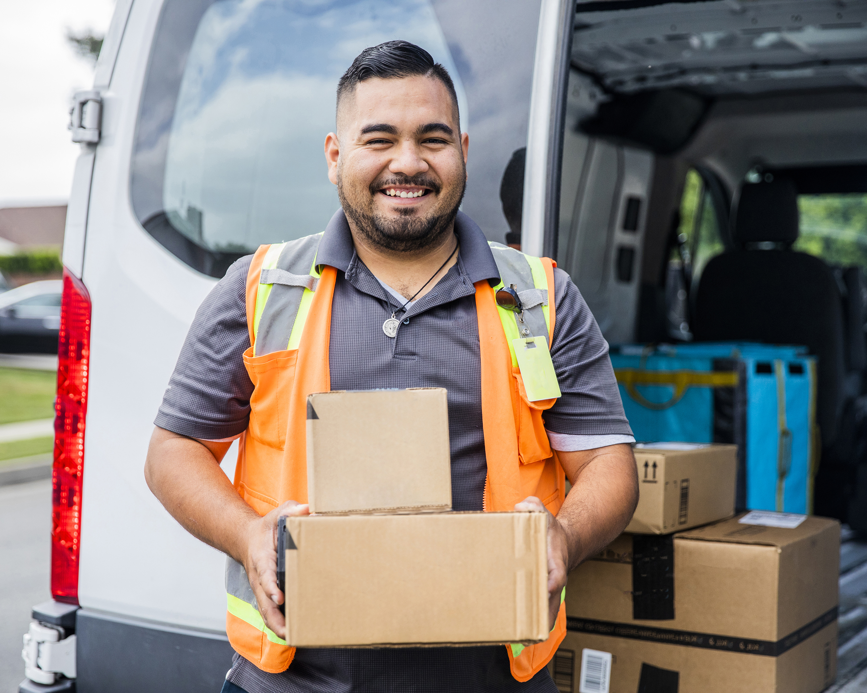

What eCommerce Customers Want
Benefits to retailer
Expected delivery times
Price transparency / DDP
Tracking visibility
Reduced customer queries
Delivery options; neighbour/store
Timed delivery window (2 hours)
Collect from local store/Locker Box
Improved customer experience
Return options
Drop-off points; store/Locker Box
Prompt refunds/replacements
Repeat orders and customer retention
Copyright MDS Alignment LTD. 2026

Slide 43
🛒 Cross-border eCommerce: Key Terms
Term | Meaning | Benefits / Drawbacks
B2C | Business to Consumer | Retailers selling directly to shoppers; usually smaller parcels, faster delivery expectations with high customer experience expectations
B2B | Business to Business | Larger shipments to other companies; often palletised or bulk freight, booking slots with deadlines
C2C | Consumer to Consumer | Goods sold online by consumers to consumers; Marketplaces i.e; Vinted, eBay
Marketplace | Online platform connecting multiple sellers to buyers | Amazon, Etsy, eBay; strict rules on delivery speed and tracking visibility
DDP | Delivered Duty Paid | Seller pays duties/taxes; smoother customer experience for consumer
DAP | Delivered at Place | Buyer pays duties; cheaper for seller but can provoke abandonment at checkout reducing sales through repeat orders
FBA / FBM | Fulfilled by Amazon / Fulfilled by Merchant | Different ways sellers handle storage and shipping on Amazon. Opportunity for freight forwarders with restrictions on book-in slots
3PL | Third-Party Logistics provider | Offers storage, pick & pack, and shipping
Last Mile | Final delivery to the customer | Crucial for speed and customer satisfaction
Reverse Logistics | Returns process | Can be complex and costly without the know-how and automation; brands need help here in the growing need to understand the benefits

Slide 44
Net Promoter Score
How a supply chain partner can influence NPS
Negative Impacts
Missed Delivery Promises: Late orders quickly create detractors.
Poor Tracking Visibility: Unclear shipment status drives frustration.
High Damage Rates: Damaged goods on arrival erode trust and repeat business.
Customs Delays: Poor documentation or descriptions cause negative experiences.
Complex Returns: Long or costly return processes have a major NPS impact.
Inconsistent Packaging or Branding: Customers may perceive lower quality.
Positive Impacts
  Fast, Reliable Delivery: Meeting or exceeding delivery promises boosts satisfaction.
  Real-Time Tracking: Transparent updates reduce customer anxiety and WISMO calls.
  Accurate Orders: High OTIF (On Time In Full) leads to trust and repeat purchases.
  Hassle-Free Returns: Easy return labels, prepaid postage, and quick refunds improve loyalty.
  Local Fulfilment Centres: Reducing lead times in key markets.
What negative impact can be caused by a supply chain partner?
Copyright MDS Alignment LTD. 2025

Slide 45

Key online international sales events
Black Friday / Cyber Monday weekend
Mother’s Day and Father’s Day
Amazon Prime Day
Valentines Day
Singles Day
~
Religious holidays:
Christmas, Easter, Ramadan, Eid, Rosh Hashanah,
Yom Kippur, Sukkot, Hanukkah, Diwali, Holi, Navratri, Vaisakhi

Slide 46



Country Specific Celebrations
Brazil
Lovers’ Day (June 12) generates their biggest online sales
Japan
16 national holidays including White Day, a month after Valentine’s Day and Fukubukuro, or ‘lucky bag’, a traditional new year custom where retailers sell sealed bags of discounted products…now a key
online shopping event
Thailand
Songkran festival in April, the Thailand Grand Sale between July and September

Slide 47
The language eCommerce
What does each acronym stand for?
LITs
AOV
NPS
CX
RTO
LITs - Lost in Transits
AOV - Average order Value
NPS - Net promoter Score
CX - Customer Experience
RTO - Return to Origin
Which of these haven’t you come across before?
Why do you think it’s important for you to know them?
Copyright MDS Alignment LTD. 2026

Slide 48
SECTION 5
Tech, Tools and Platforms
Cross-Border eCommerce: From Basics to Business Growth

Slide 49







WHAT YOUR OPERATION NEEDS TO HANDLE
Every one of these is already second nature to someone in eCommerce logistics.
For most freight professionals, at least three are unfamiliar territory.
Pre-Advice Data
API
Integration
Tracking
& Events
Label
Standards
EDI vs
API
Customs
Systems
Returns
Portals
Data before
the aircraft lands
Real-time
systems talk
Every scan,
everywhere
Carrier-specific
Old world
vs new world
CDS, AES,
ICS2
Automated credits
Which of these does your current operation handle? Where are there opportunities?

Slide 50
EDI
API
The Old World
The New World
Batch files sent at set intervals
Real-time, event-driven
Point-to-point, format-specific
Platform-agnostic
Expensive to maintain
One connection, many carriers
Slow and brittle at volume
Errors surface and fix instantly
You already know this world
This is the new entry requirement
It works.
But not at eCommerce scale.
This is what eCommerce
operators expect from day one.

Slide 51

A client
with too many data systems to integrate causes you (and them!) headaches.

Slide 52
?
Open Question
In your current operation, where does data
fail first and who notices before you do?
Think about a specific shipment. Where did visibility disappear?

Slide 53
Commercial
Models
The pricing logic is completely different from airfreight.
Everything you know about yield needs to be reframed.

Slide 54
HOW THE PRICING WORKS
Per parcel.
Not per kg.
Zone 1
vs Zone 6.
Volumetric weight profile.
Surcharges
erode margins.
Unit economics shift entirely.
Dead weight is less relevant.
Volumetric weight, Delivery zone,
volume of parcels are everything.
In-country delivery zones drive your final-mile base rate. The same parcel, different in a different zip code, can cost 3x more to deliver.
Dimensional weight is essential to know upfront.
Sending duvets is likely to cost more than sending sheets.
Fuel and remote area surcharges are real and variable. Always model them before quoting a blended rate.

Slide 55
?
Open Question
Which of these
revenue streams
is closest to what
you already do?
And what is the one step between where you are now and where you want to be?

Slide 56
REVENUE STREAMS-LOWEST TO HIGHEST BARRIER TO ENTRY
Start where you are. Build outward.
1
Linehaul Consolidation
Your usual service.
No new infrastructure needed.
2
Customs Clearance
Most mid-market sellers cannot do this themselves.
3
Last-Mile Injection Agreements
Revenue share model.
Leverage existing carrier relationships.
4
Returns Management
Aggregation + consolidation to lower cost point.
5
Fulfilment & 3PL Services
Highest potential margin.
Requires WMS investment.
6
Value-Added Services
Sorting, relabelling, repackaging.
Bolt-on to 3PL. High margin.

Slide 57
The operators
who win don't
try to do
everything
at once.
KEY TAKEAWAYS
01
Data is the new infrastructure
If you cannot handle parcel-level electronic pre-advice, APIs, and track events, you cannot play in eCommerce logistics.
02
Price by parcel, think by zone
Stop translating to kg. Build your commercial models around per-parcel rates, surcharges, and dimensional weight from the start.
03
Start with your next logical step
They focus.
They build volume.
Then they expand.
Every operator in this room has at least one revenue stream they can enter this year with what they already have.

Slide 58
SECTION 6
How Your
Business Can Expand
Cross-Border eCommerce for Logistics Professionals

Slide 59

It takes a mindset change

Slide 60

You need more than your head to make aligned decisions…
Use your mindset and ask yourself:
Is it logical and do we have the know-how?
How does it benefit others and is it aligned with our values?
What’s my instinct saying?
Copyright MDS Alignment LTD. 2026

Slide 61
Think Bigger…
Capability already exists
The market is not sewn up
Everyone in the room has three things that eCommerce logistics companies have spent years and millions trying to build:
Physical infrastructure
Carrier relationships
Customs knowledge
It’s about thinking differently to how you have before.
Big integrators like DHL eCommerce, Evri, DPD, PostNL have scale but lack flexibility
They can be weak on bespoke solutions for mid-market sellers.
That is exactly where traditional logistics operators can compete.

Slide 62
Where you may need to adapt
Traditional airfreight was built for large shipments, pallets, containers.
eCommerce requires:
Smaller, more frequent shipments
Integration with online platforms and fulfilment networks
Visibility: tracking updates synced to consumer apps
Flexible solutions for B2C, B2B and hybrid models
This is where you can offer real value by demystifying customs, bundling services, and offering scalable solutions
Copyright MDS Alignment LTD. 2026

Slide 63

B2C OPPORTUNITIES
eCommerce Consolidation
Customs Filing
Scan and label consolidated bags and pallets correctly for parcel carriers.
Manage customs filing connected to the seller’s system via API. Creating recurring, scalable revenue.
Freight Forwarder
Bonded Warehouse
Returns Consolidation
Hold eCommerce inventory duty-deferred.
Value proposition for high value goods
Consolidate consumer returns and ship back in bulk.
A real competitive advantage when you get this right.
TODAY
Moving consolidated cargo, B2B, on behalf of importers and exporters. Revenue from handling, documentation, and transport margin.
PRACTICAL CHALLENGE
Customs authorities require electronic pre-advice at line-item level.
Existing back-office systems may not handle this currently; build or invest.

Slide 64

B2C OPPORTUNITIES
Dedicated eCommerce Products
Peak Capacity Brokering
Co-design a product with airline on the principals: Defined transit time, electronic data requirements, parcel-friendly handling, competitive pricing.
Broker additional belly capacity during Singles Day, Black Friday, and Christmas peaks.
GSSA
Full eCommerce Commercial
Data Compliance as a Service
Manage the airline's entire eCommerce commercial strategy: Product design, and customer relationships. Renegotiate commission structures.
Receive pre-advice from shippers, validate, enrich, and submit data to the airline in the correct format.
TODAY
Selling airline cargo capacity on behalf of carriers. Revenue from uplift commission. Deeply connected to airline rate structures and routing.
PRACTICAL CHALLENGE
Moving into product ownership or service wrapping requires a different commercial commission model that reflects the value being created.

Slide 65

B2C OPPORTUNITIES
eCommerce Gateway Facility
Customs Fast-Track Lane
Break inbound consolidated shipments by post/zip code and inject into domestic carrier networks.
Removes off-airport trucking cost.
Establish a dedicated eCommerce customs channel with electronic pre-filing, automated risk scoring, and sampling for compliant shipments.
Airport Operator
Bonded eCommerce Zone
Carrier Tenants
Designate cargo space as a bonded zone. Hold retailers stock duty-deferred, pick and pack to order, and charge duty only at the point of despatch.
Position as eCommerce-friendly to attract parcel carriers as tenants. Volume creates revenue; Justifies further infrastructure investment.
TODAY
Managing landside and airside infrastructure, handling charges, warehousing, and cargo coordination. Revenue from fees, ground rent, and handling
agreements.
PRACTICAL CHALLENGE
Grounded business case with clear evidence of the opportunity before escalating. Soft advocacy without numbers goes nowhere.

Slide 66

B2C OPPORTUNITIES
Sortation Services
Last-Mile Injection
Scan inbound eCommerce bags, sort by post/zip code or carrier routing, load into outbound carrier vehicles. Requires scan-and-sort technology investment.
Receive parcels from airline, consolidate by delivery zone, hand to last-mile providers. Handling fee per parcel plus potential revenue share.
Ground Handler
Returns Processing
Value-Added Services
Receive, scan, sort, and consolidate inbound consumer returns for bulk RTO. Commercial relationship with retailer or returns platform such as ZigZag.
Repackaging, relabelling, and spare shed capacity. Higher margins than basic handling and commercial relationships with eCom operators.
TODAY
Physical handling of aircraft, cargo, and ramp operations. Revenue from per-turn and per-tonne handling fees. Focused on speed and safety of aircraft turnaround.
PRACTICAL CHALLENGE
New services need careful volume modelling before committing to equipment or headcount. Define the minimum viable volume threshold first.

Slide 67

B2C OPPORTUNITIES
Dedicated eCommerce Product Tiers
Dimensional Weight Policy Review
Defined transit time, electronic data requirements, and pricing that reflects value to eCommerce operators, not just weight.
Create a parcel-specific volumetric ratio. Current 1:6 policies makes eCommerce economically unviable for shippers.
Airline
Direct Consolidator Relationships
Direct Consolidator Relationships
Build commercial relationships with the top 10-20 eCommerce consolidators in key origin markets.
Capture data, insight, and margin currently sitting with intermediaries.
TODAY
Moving cargo in belly hold or on freighter under IATA frameworks. eCommerce is likely a growing revenue share but probably not managed as a distinct commercial segment.
Real-Time Track and Trace
Pre-Sold Peak Capacity
Scan events at acceptance, loading, departure, arrival & transfer via API. Transforming airline to offering full visibility.
Offer peak-season freighter capacity on a pre-sold basis. Revenue for the airline; capacity certainty for eCommerce operator.
PRACTICAL CHALLENGE
Building a yield-per load factor improvement, and revenue diversification.

Slide 68

The Unifying Opportunity
No single role needs to act alone.
GSSA
Ground Handler
Freight Forwarder
Sells capacity
and structures
the eCommerce product
Processes parcels
at the gateway and
injects last-mile
Handles customs filing
and returns
consolidation
Together, a GSSA, ground handler, and customs-capable freight forwarder can offer a complete cross-border parcel solution, competing on specific trade lanes with existing infrastructure and no capital requirement

Slide 69
SECTION 7
How to Attract and Work
With eCommerce Clients
Cross-Border eCommerce for Logistics Professionals

Slide 70

Know
Them and their company
Visit their site
Meet their people
Like
Similar values
Mutual respect
Listening skills
Trust
They ask / You answer
Honest Feedback
Transparency on cost and limitations
Copyright MDS Alignment LTD. 2026

Slide 71
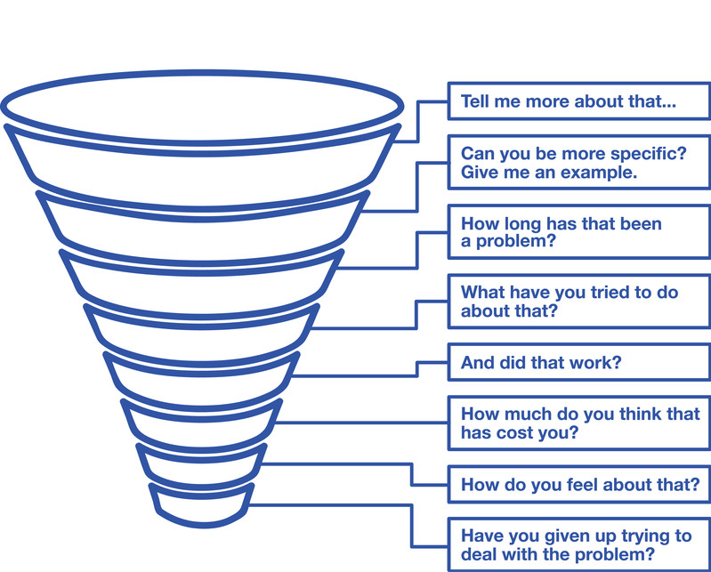
Identify reasons for doing business
The pain funnel questions
80% + listening
20% < talking
Avoid scripting these questions.
Go through the 3 layers of questioning:
Intellectual : business : personal
Use open-ended questions:
What, where, when, how, why, who

Slide 72

Identify your competitive advantage
Why do your customers engage with your company?
What problems do you help them solve or avoid?
What do your help them to achieve?
Why do your customers buy from you?
Who are your main competitors?
What do you have to offer customers that they can’t obtain from your competitors?
What would your customers, lose, forfeit, or miss out on by not using your company?
Never sell on price alone!
Copyright MDS Alignment LTD. 2026

Slide 73

Case Study
How we won the international business of a retail brand and helped them grow into a global sensation by becoming a trusted partner in their eCommerce journey,
and what we learned along the way…
Copyright MDS Alignment LTD. 2026

Slide 74

Understand
How their supply chain works today
Their key markets
Aspirations for the future and timeline for getting there
Identify
Where their pain points are?
What would they change now?
What’s stopping them?
Share
Benefits of working with your company
Solutions you can offer based on their feedback
What’s in it for them
Copyright MDS Alignment LTD. 2025

Slide 75

It’s not about gaining a customer
It’s about building a partnership

Slide 76
SECTION 8
Key Takeaways
and Next Steps
Cross-Border eCommerce for Logistics Professionals

Slide 77

Key Takeaways
eCommerce is now the backbone of global retail, and it touches every market
Knowing the difference between B2C, B2B, D2C, and marketplaces helps you design better offers
Success means getting your customers to KNOW, LIKE and TRUST you by offering them great customer experience
Suppliers who adapt can become real partners, not just carriers
Copyright MDS Alignment LTD. 2026

Slide 78
Summary of what we covered
The eCommerce landscape; growth trends and global markets
Cross-border eCommerce 101; what eCommerce customers want
Essential eCommerce Terminology; the language of retailers and why NPS matters
Tech, Tools & Platforms; importance of API integration to grow and scale your business
Where you are in the eCommerce Supply chain; areas of opportunity for growth
How to attract & work with eCommerce clients; the principle of know, like, trust, and how to adapt to become partners, not just carriers
Copyright MDS Alignment LTD. 2026

Slide 79
Next Steps
Identify eCommerce niches example;
fashion, supplements, household goods, sports gear
1
Define your offer for existing & potential eCommerce clients
2
Approach your existing customers first
3
Reach out to NeX Academy for online learning/training opportunities
4

Slide 80


Your Gateway to EXCELLENCE: ‘Best in Class eCommerce Logistics’
Support
Feedback

Slide 81

: MASTERCLASS
Cross Border eCommerce: Basics to Business Growth
By: Mandy Deakin-Snell

Slide 82
?
Open Question
ANY QUESTIONS
What’s been most valuable from this Masterclass?

